Slide 1

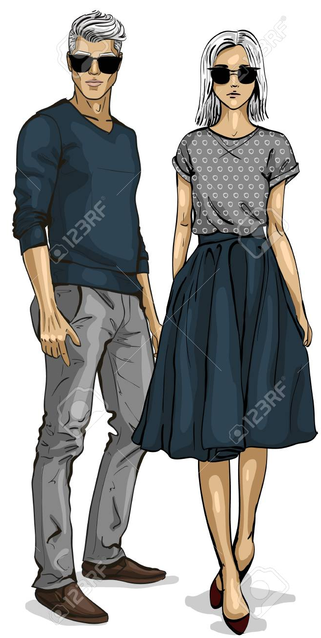
Pocket Fashionista - A Complexion based Outfit Color Advisor
Computer Engineering Department
Project Guide : Prof. Reeta Koshy
Group Members :
Tejashri Wagh - 2018230077
Anisha Gharat - 2018230071
Siddesh Sonawane - 2017130059

Slide 2
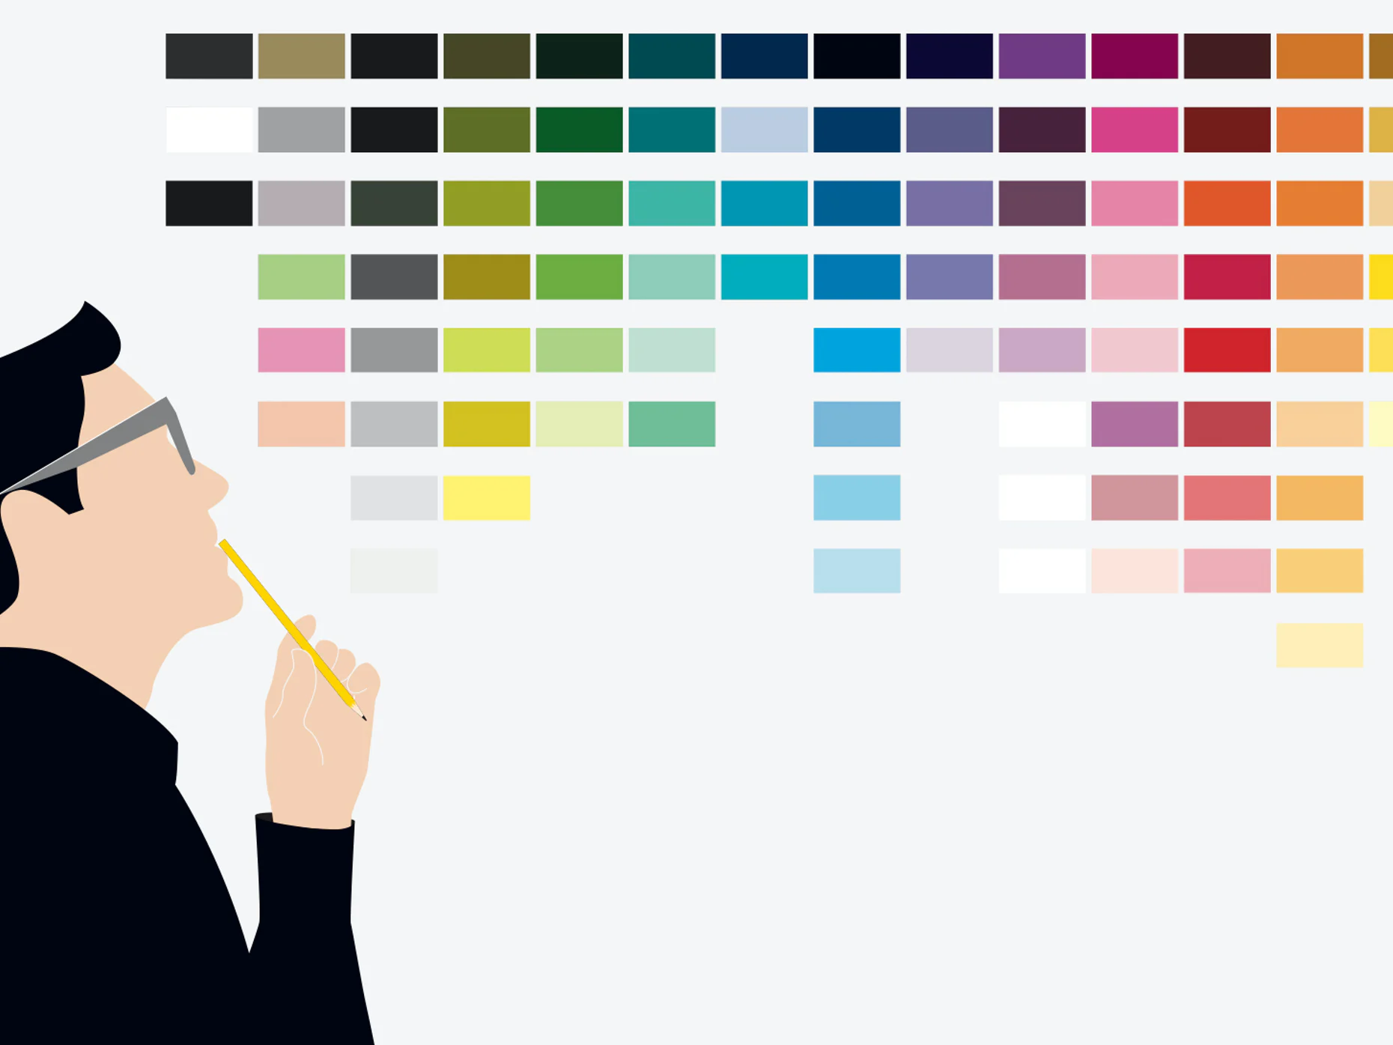
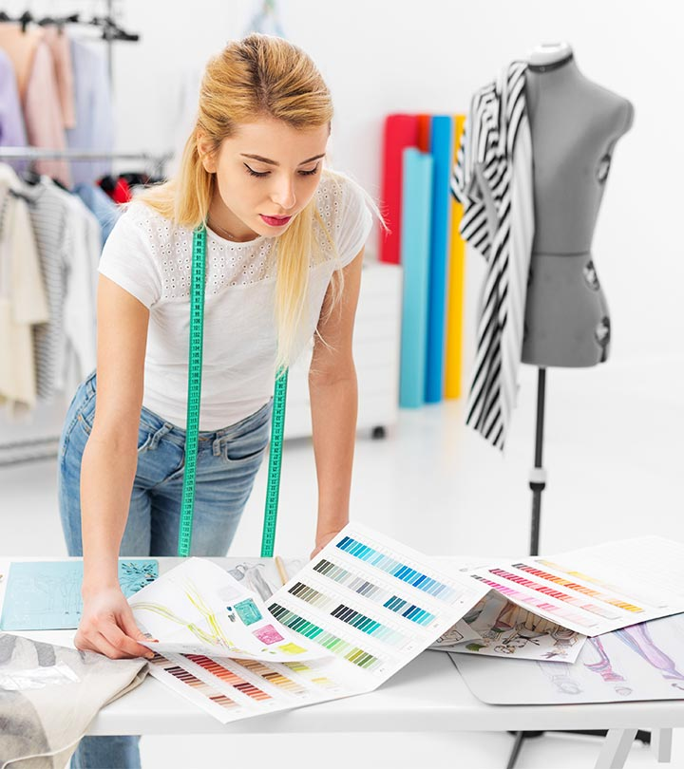
Problem/Issue Discussion
.
Online portals do not facilitate suitable color combinations and contrasts
Complexion of models on e-commerce website do differ with the actual skin tone of the buyer resulting the product being returned back.
There is always a confusion about which coloured jeans will go on the top or vice versa
User keeps saving photos of fashion vloggers to know the color trend but is unable to find something suitable for himself/herself

Slide 3




Project Idea (Problem statement)
People usually find it difficult to get the best clothing color combinations that suit their skin tone well and go well with the existing fashion trends.
The aim is to develop a complexion based clothing color recommendation system that will help to choose the best possible clothes color combinations.
It will also allow the users to virtually visualize how they will look in the recommended color combinations.
The application will allow users to make best choices with their clothes color combinations and thus saving their time and energy in even trying out the clothes.
Easy for merchants to master the real-time demand of consumers.
Uploads photo and wishlist
Generate color
recommendations based on weather and occasions
Detect
Skin tone
Real time Demo trial
WebApp
User gets
response as different color combinations of outfits
Analyze
wishlist
to
recommend

Slide 4
Tentative Work Plan
Complexion Detection
Reviewing User’s Wishlist+Wardrobe
Occasional/Weather
based recommendations
Virtual Trial Demo
Occasions/Weather based recommendations
The user will upload his/her picture.
The system will classify the person’s skin tone from the Indian skin tones meter.
The skin complexion which best suits the user will be further used to determine the color combination of the clothes.
The user’s wishlist will now be checked.
The color combination of shirt and pant that suits the most according to his/her skin tone will be recommended.
The existing clothes in the wardrobe of the user can also be shuffled so as to give different combinations.
According to the ongoing season the color combination of the clothes will be recommended that will best suit the weather-oriented trend.
Recommendations will also be made based on the ongoing festive occasions and any event in the person’s life.
Based on the recommended color combination of the clothes the user will get a demo trial on the prebuilt models or his own live picture.
This way the user will be able to try out the suggested outfit without even trying it on.

Slide 5
References
Q. Deng, R. Wang, Z. Gong, G. Zheng and Z. Su, "Research and Implementation of Personalized Clothing Recommendation Algorithm," 2018 7th International Conference on Digital Home (ICDH), Guilin, China, 2018, pp. 219-223, doi: 10.1109/ICDH.2018.00046.
Y. Liu, Y. Gao, S. Feng and Z. Li, "Weather-to-garment: Weather-oriented clothing recommendation," 2017 IEEE International Conference on Multimedia and Expo (ICME), Hong Kong, 2017, pp. 181-186, doi: 10.1109/ICME.2017.8019476.
L. Yu-Chu, Y. Kawakita, E. Suzuki and H. Ichikawa, "Personalized Clothing Recommendation System Based on a Modified Bayesian Network," 2012 IEEE/IPSJ 12th International Symposium on Applications and the Internet, Izmir, 2012, pp. 414-417, doi: 10.1109/SAINT.2012.75.

